Slide 1
SCHOOL TRAINING 2024-2025
District Contact Information
Dr. Leah Torres: leah.torres@osceolaschools.net ext 66155
Britt Bell: britt.bell@osceolaschools.net ext 66017

Slide 2
SAC Member Requirements
SAC
It is the School’s responsibility to ensure that all SAC Members are OASIS approved volunteers in accordance with Section 943.04351, F.S.

Slide 3

SAC Meetings
It is preferred that SAC meeting will be conducted face to face. Face masks will be optional.
SAC meetings can be made available to virtual attendees in order to increase participation and involvement, but SAC members attending virtually may not be counted toward quorum. However, if a quorum of a local board is physically present, “the participation of an absent member by telephone conference or other interactive electronic technology is permissible when such absence is due to extraordinary circumstances such as illness…whether the absence of a member due to a scheduling conflict constitutes such a circumstance is a determination that must be made in the good judgment of the board” (AGO 03-41).

Slide 4
Florida Statute 1001.452 SAC Membership
SAC
Principal membership is mandatory
All voting members must be chosen or elected by peers.
  Teachers elect teachers
  Support staff elect support staff
  Parents elect parents
  Principals can appoint community members
The composition must represent the racial, ethnic and economic status of the school community
Assistant Principals can attend SAC meetings but cannot be a SAC Member or a Board Member e.g., SAC Chair, Secretary or Treasure

Slide 5
Florida Statute 1001.452 SAC Membership
SAC
Majority of the members are non-district employees (51%) Students of appropriate age are required to be members of SAC at the middle and high school level.
A completed SAC roster must be provided to the Office of School Improvement according to the district timeline.
If the SAC membership changes, an updated roster must be provided to the Office of School Improvement.

Slide 6
Responsibility of SAC
SAC
Each school advisory council shall adopt bylaws establishing procedures for:
1. Requiring a minimum of 8 meetings per year, in accordance with district policy.
2. Requiring a quorum to be present before a vote may be taken by the school advisory council. A majority of the membership of the council constitutes a quorum. A meeting can be conducted without a quorum, but no voting items can be discussed or voted on.
3. Requiring at least 3 days’ advance notice in writing to all members of the advisory council of any matter that is scheduled to come before the council for a vote.
4. Scheduling meetings when parents, students, teachers, businesspersons, and members of the community can attend.
5. Replacing any member who has two unexcused consecutive absences from a school advisory council meeting that is noticed according to the procedures in the bylaws.
6. Recording minutes of meetings and all meeting minutes, meeting agendas, and meeting attendance should be emailed to the Office of School Improvement (Britt Bell) by the following month following the meeting.
Florida Statutes section 1001.452(1)(d)(4)

Slide 7
Florida Statute 1001.452 Primary Functions of SAC
SAC
To assist in the preparation and evaluation of the School Improvement Plan (SIP) by giving insight and feedback
To assist in the preparation of the school budget.
To assist in the completion of the Mid-Year Review of the SIP by giving insight and feedback
To encourage innovation at the school
To perform other functions as requested by the School Board and principal.

Slide 8
School Advisory Council Mini Conference
Date : TBA

Slide 9

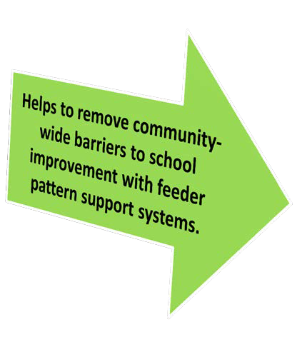
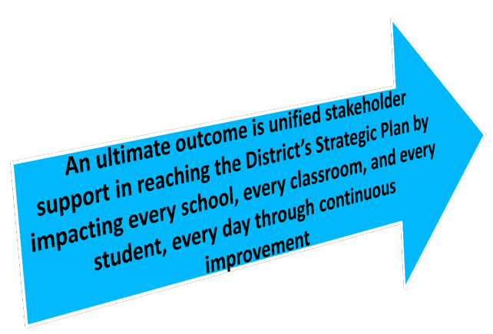
Making Connections
School Advisory Council
Superintendent
(Support from District Staff)

Slide 10
Mid-Year Expectations
SAC
Meaningful stakeholder input is vital to the school and district.
Each School Advisory Council (SAC), in cooperation with various identified community stakeholders that work with the school, is to conduct an annual midyear reflection as part of the SIP process and submit to FLDOE through the CIMs Platform.
Agenda and minutes will be submitted to the Office of School Improvement every month.

Slide 11
School Improvement Funds (if available)
Funds can be used for School Improvement Plan development or implementation only.
SACs must reference specific objectives and/or strategies in the School Improvement Plan.
The School Advisory Council decides on how the School Improvement Funds will be spent.
SAC funds must be spent on the needs of the individual school and cannot be transferred between schools.
The principal may not override the recommendations of the SAC.
School Improvement Funds may not be used for capital improvements, such as, construction, renovation remodeling, or site improvement.
SACs are encouraged to use the funds to meet current needs rather than having the monies committed to recurring needs, but SAC can approve recurring needs if voted on.
Fund expenditures should be reflected in the SAC minutes with signed documentation sent to the budget department.

Slide 12
School Recognition Funds
All selected schools shall receive financial awards depending on the availability of funds appropriated and the number and size of schools selected to receive an award.
Funds must be distributed to the school’s fiscal agent and placed in the school’s account and must be used for purposes listed in subsection (5) as determined jointly by the school’s staff and school advisory council.
If school staff and the school advisory council cannot reach agreement by February 1, the awards must be equally distributed to all classroom teachers currently teaching in the school. Sec. 1008.36(4) F.S.
Fund expenditures should be reflected in the SAC minutes with signed documentation sent to Human Resources

Slide 13
Tentative Dates August – September 2024
Ensure all FY24/25 SAC voting members have been added on the SAC Membership Compliance form and recorded in minutes and submitted to Britt Bell
School Improvement Plan Approval Form completed
Review Sunshine Law, Roberts Rules and SAC By-Laws with SAC members and recorded in minutes
SAC Checklist Completed
All documents submitted to Britt Bell @Deputy Superintendent of Teaching, Learning and Leading by September 23, 2024

Slide 14
SAC
August 2024
CS & I schools submit their School Improvement Plan to the FLCIM to the Bureau of School Improvement for review
School Improvement Plan review and feedback provided by Office of School Improvement
School Improvement Plan SAC approval and recorded in minutes
School Improvement Plan review and feedback provided by REA
SAC Meeting information form due. Approved and recorded in SAC minutes September 2024
SAC Checklist, SIP Approval and SAC Membership form to be submitted to the Britt Bell by September 23, 2024. Approval recorded in SAC minutes
October 2024
School Board Approval as required by SB Policy 2.09 (8e)
District approves SIPs in CIMS for publication
November 2024
All School Improvement Plans within the FLCIM published by November 1, 2024, by District
School Improvement Plan Assurances (District)
February 2025
Mid-Year Reflection submitted to FLDOE CIM

Slide 15
Monthly Meetings to Include Agenda Item
SAC
S
Update on 2024-25 SIP Areas of Focus and Action Steps (positives and concerns)and changes made
Feedback to be recorded in Minutes

